Slide 1
Chapter 17. Applying Patterns to Design a Persistence Framework
Command

Slide 2
Command Pattern

Slide 3
Intent
Encapsulate a request as an object, thereby letting you parameterize clients with different requests, queue or log requests, and support undoable operations.
16-<number>

Slide 4
Also Known As
Action, Transaction
16-<number>

Slide 5
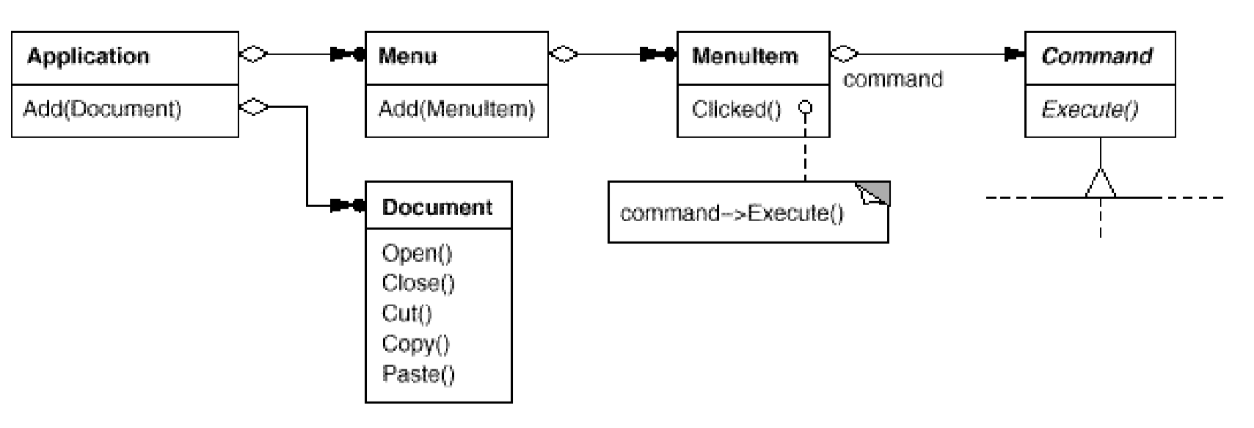
Motivation
The application configures each MenuItem with an instance of a concrete Command subclass. MenuItems don't know which subclass of Command they use.
The key to this pattern is an abstract Command class, which declares an interface for executing operations.
Concrete Command subclasses specify a receiver action pair by storing the receiver as an instance variable and by implementing Execute to invoke the request.
The receiver has the knowledge required to carry out the request.
13-<number>

Slide 6
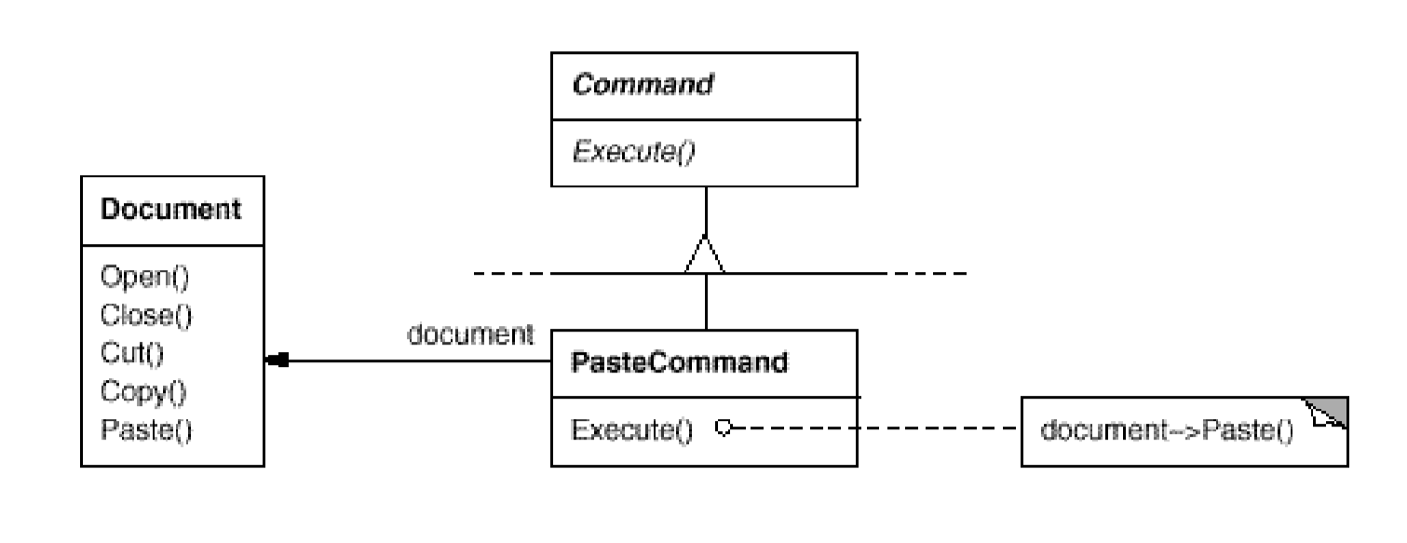
PasteCommand supports pasting text from the clipboard into a Document. PasteCommand's receiver is the Document object it is supplied upon instantiation.
The Execute operation invokes Paste on receiving Document.
13-<number>

Slide 7
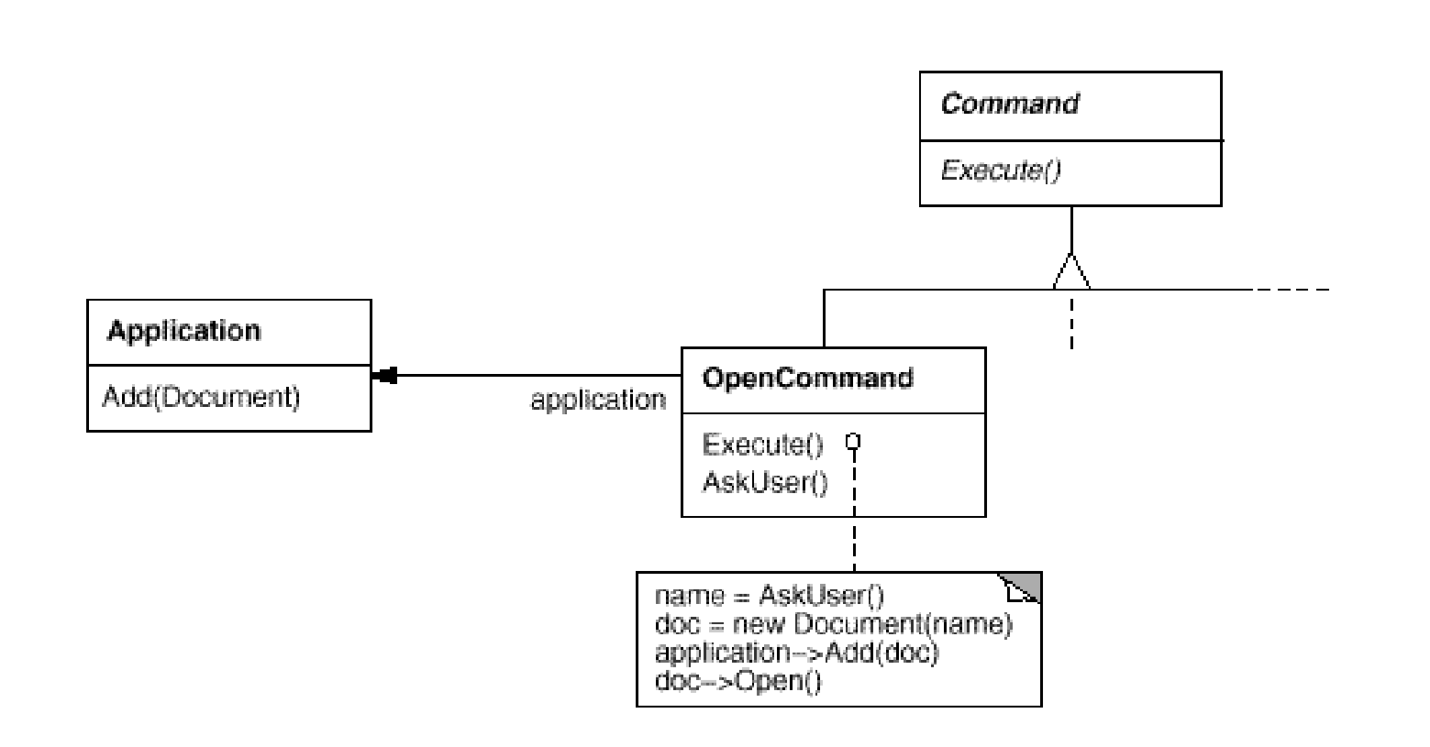
OpenCommand's Execute operation is different: it prompts the user for a document name, creates a corresponding Document object, adds the document to the receiving application, and opens the document.
13-<number>

Slide 8
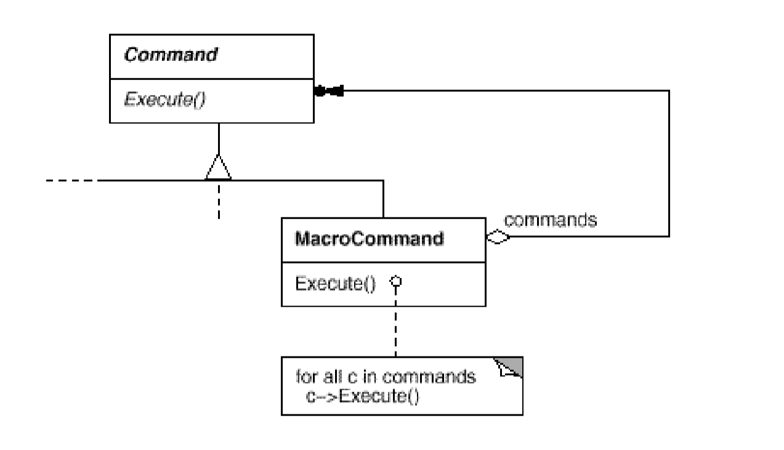
MacroCommand is a concrete Command subclass that simply executes a sequence of Commands.
MacroCommand has no explicit receiver, because the commands it sequences define their own receiver.
The key to the MacroCommand is its Execute member function. This traverses all the subcommands and performs Execute on each of them. The MacroCommand is also responsible for deleting its subcommands.
13-<number>

Slide 9
Applicability
Use the Command pattern when
parameterize objects by an action to perform. A function that's registered somewhere to be called at a later point
specify, queue, and execute requests at different times
support undo
support logging changes so that they can be reapplied in case of a system crash
structure a system around high-level operations built on primitives operations.
16-<number>

Slide 10
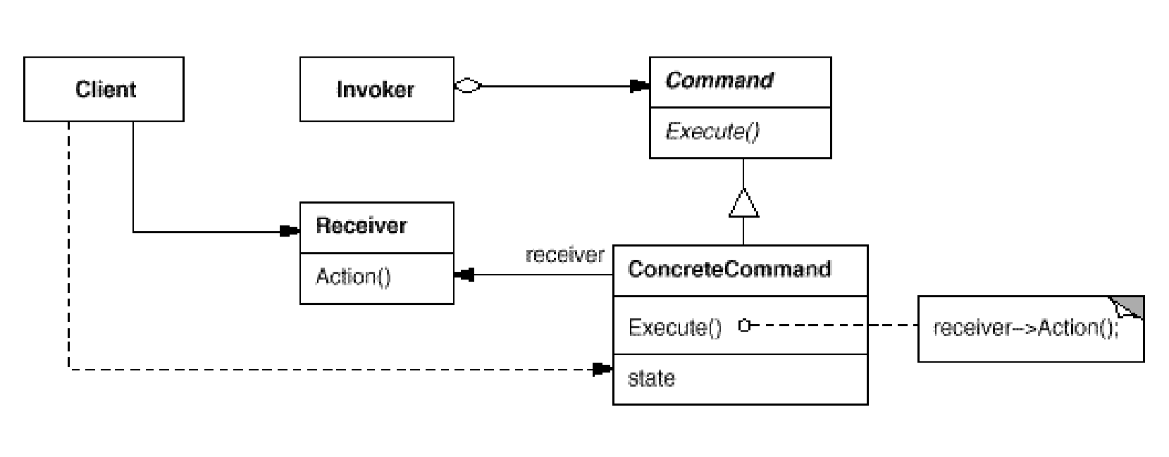
Structure
17-<number>

Slide 11
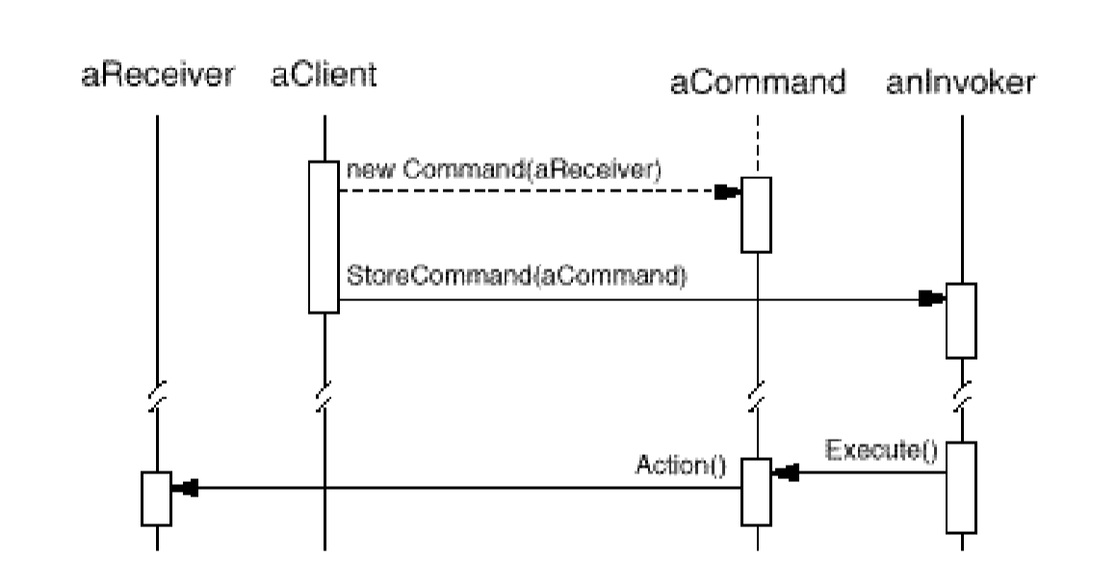
17-<number>

Slide 12
Applying Command Pattern
SQL Access
delegate
executes a query to save the book to the database. Return null.
getUser(uid):User
getBook(callNo):Book
saveLoan(loan)
saveBook(book)
SQLCmd
execute():Object
GetUser
GetBook
SaveLoan
SaveBook
GetUser(uid: String)
execute(): Object
GetBook(cn: String)
execute(): Object
SaveLoan (Loan l)
execute(): Object
SaveBook (b:Book) execute(): Object
SaveBook sb=new SaveBook(book);
sb.execute();
this.book=book;
Define a Command Interface SQL Cmd that contains an execute(): Object method.
For each client operation, implement a concrete command class that realizes the client
operation.
Each client operation delegates the work to the corresponding concrete command.
17-<number>

Slide 13
Applying Command Pattern
Invoker
setCommand(Command c)
run(){c.execute}
Receiver
SQL…
SQLAccess
Command
getUser(uid):User
getBook(callNo):Book
saveLoan(loan)
saveBook(book)
delegate
executes a query to save the book to the Receiver. Return null.
execute()
GetUser
GetBook
SaveLoan
SaveBook
Receiver receiver
GetUser(Receiver r)
execute() {…}
Receiver receiver
GetBook(Receiver r)
execute() {…}
Receiver receiver
SaveLoan (Receiver r)
execute() {…}
Receiver receiver
SaveBook (Receiver r) execute() {…}
SaveBook sb=new SaveBook(book);
sb.execute();
Define a Command Interface that contains an execute() method.
For each client operation, implement a concrete command class that realizes the client
operation.
Each client operation delegates the work to the corresponding concrete command.
17-<number>

Slide 14
Supporting Undo and Redo
To support undo and redo
  extend the command interface with following abstract operations, implemented by the command subclasses
    undo()
    redo()
    reversible():boolean, returns true if command is reversible
  maintain a history of executed commands
  each command stores the information needed to undo the command
past
present
undo
redo
17-<number>

Slide 15
Benefits of Command Pattern
Each command object encapsulates an operation or request.
The command pattern defines a uniform interface for executing different operations.
It decouples the client from the command objects.
It is easy to introduce new command subclasses.
Commands can be queued and executed at a later time.
It supports undo and redo operations.
Commands can be composed to form composite commands using the composite pattern.
17-<number>

Slide 16
Remarks
What are the similarities and differences between Strategy and Command?
17-<number>

